Slide 1
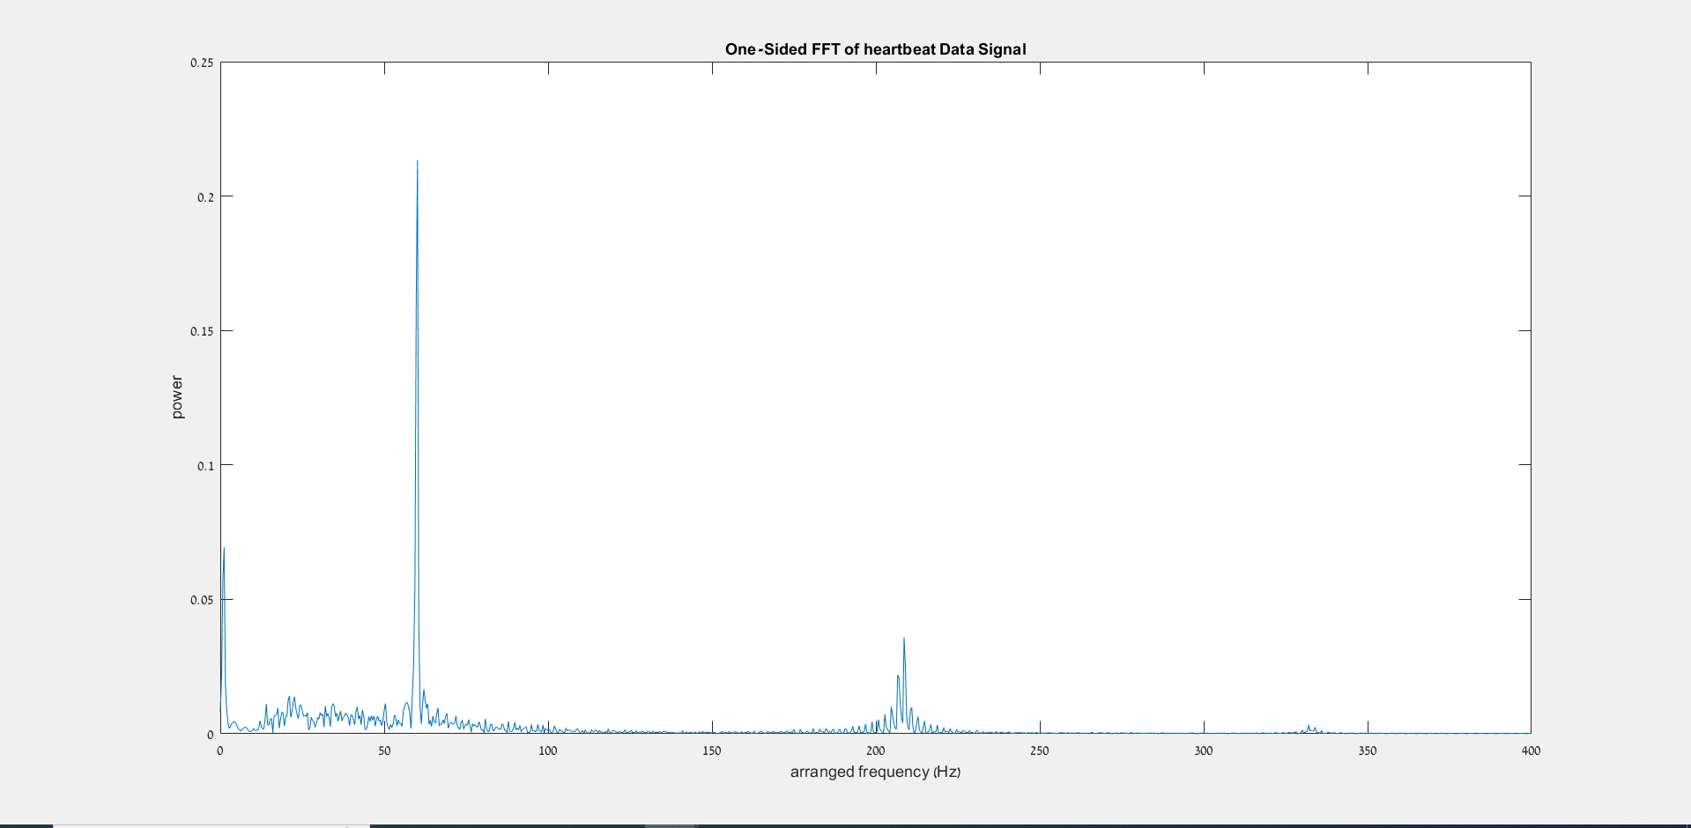
One sided FFT – original raw data of heartbeat

Slide 2
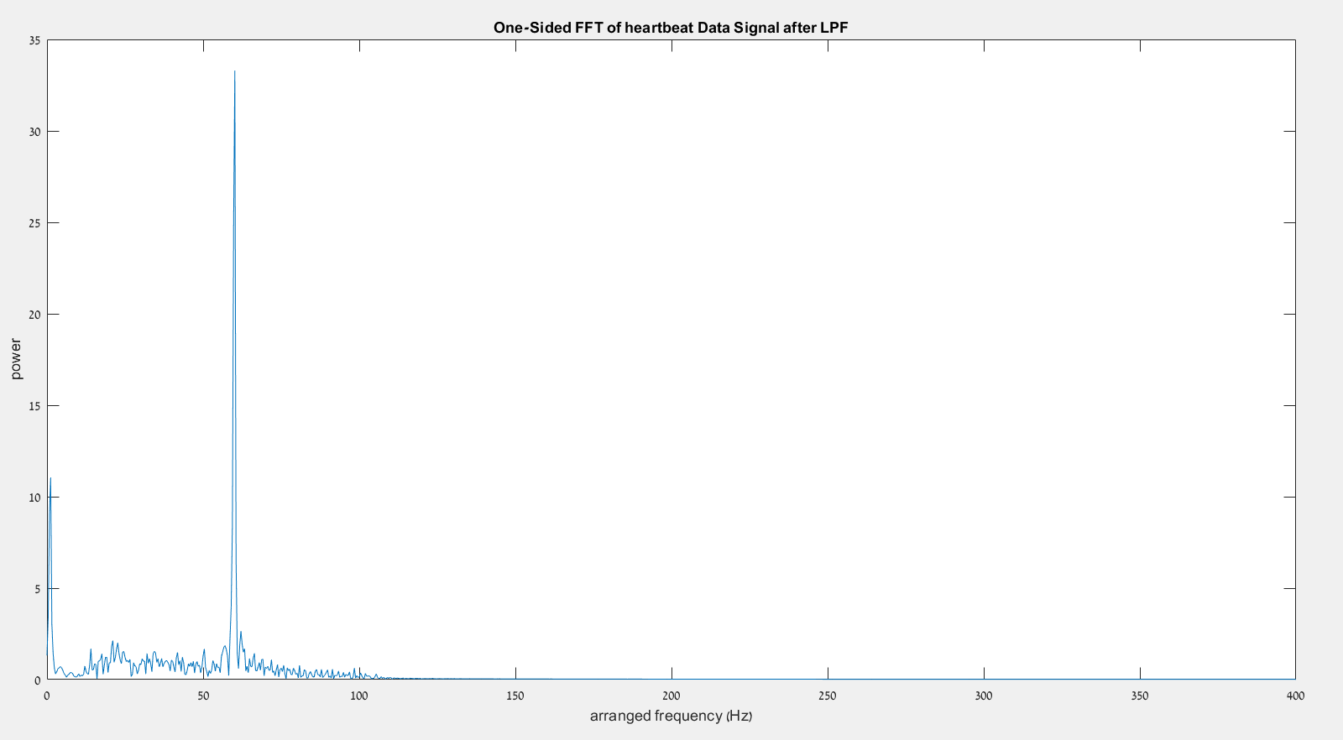
One sided FFT – after LPF (eliminated high frequencies)

Slide 3
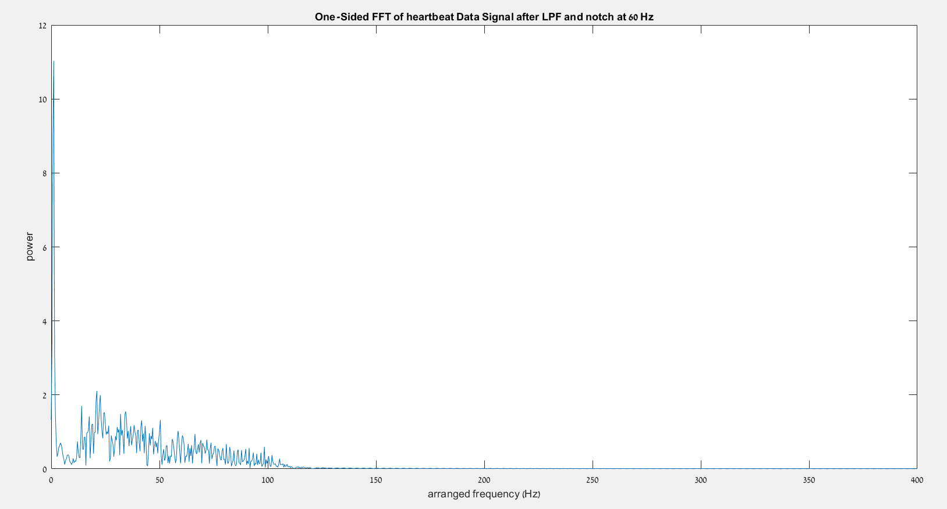
One sided FFT – after LPF (eliminated high frequencies)
And notch (eliminate 60 hz noise)

Slide 4
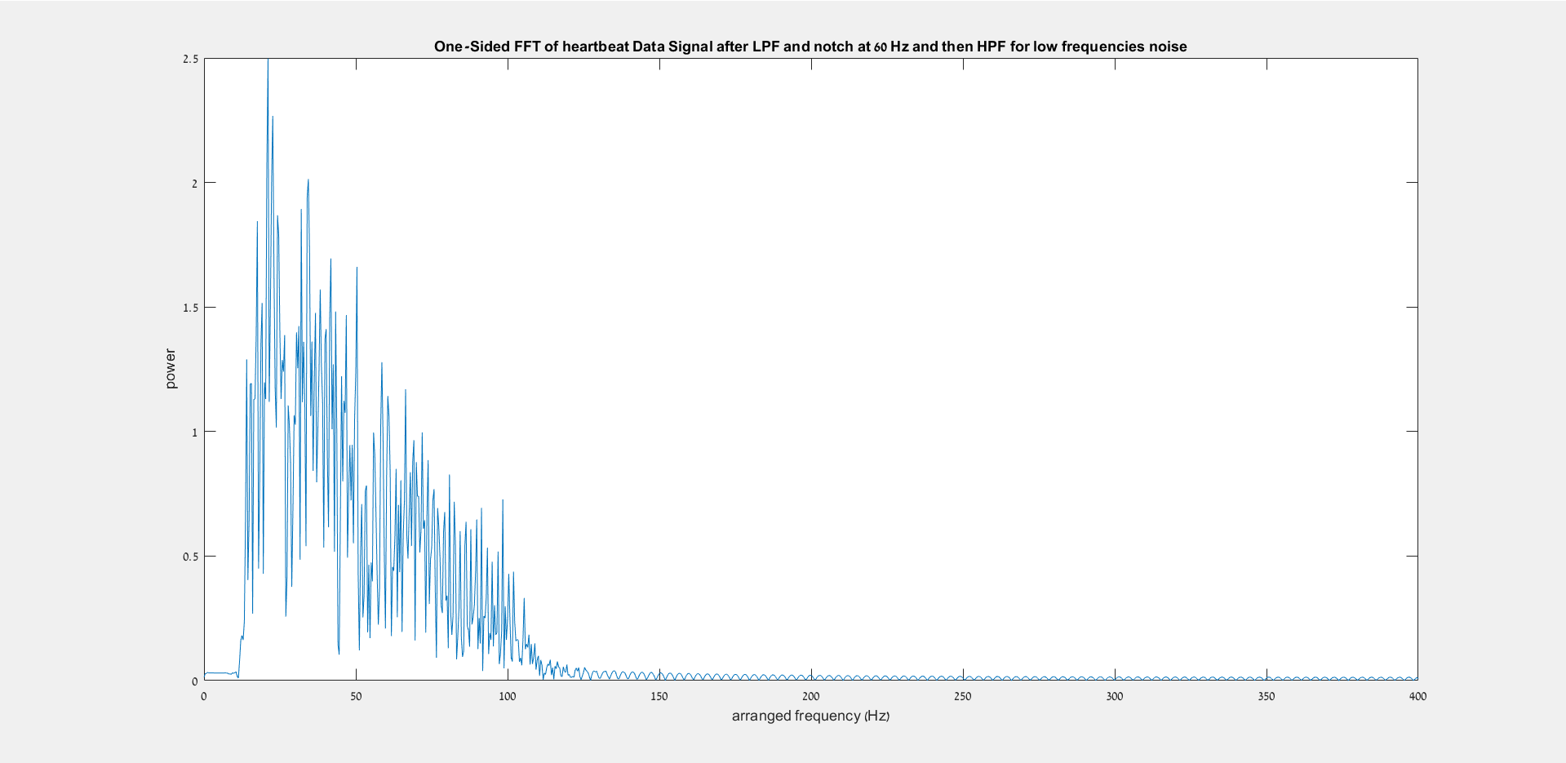
One sided FFT – after LPF (eliminated high frequencies)
And notch (eliminate 60 hz noise) and HPF (eliminate under 20 Hz noise)

Slide 6
